Slide 1
Robotic hub
221952721-KJ MTHIMKHULU
222170573-HA MATSANE
222506407-TT MALUKA
221840206-T MASANGO
222419873-TM KEKANA
222171715-KM MLOTSA
221975306-C MONGWE
222344326-AW MOKOENA
221869085-LR NEMUTANZHELA
221293167-NI MAZIBUKO

Slide 2
Table of contents Introduction……………………………...1 Problem……………………………………..2 solution 1…………………………………..3 solution 2…………………………………..4 how the website works 1………………5 how the website works 2………………6 legal and compliance………………..7 what makes the website unique…...…8 future expansion………………………...9 conclusion……………………..………..10

Slide 3

Introduction
Robotic Certifier was founded in August 2024 by Robotics Hub.
It was launched by 10 Vaal University students after having encountered a problem and thinking of ways to make the process easier as well as finding a solution for it.

Slide 4

Problem
A lot of people experience problems when they want to certify their documents because most of the time the police close that department early and there's always a long queue.
There are long lines at police stations and post offices for document certification which also result in some people not being able to certify.
It is a time-consuming process for all especially people that have jobs and have busy lives as well as people that live very far from the police station.
The inefficient use of police resources impact on Policing because there are less police outside fighting crime.

Slide 5

Solution
Robotic Certifier is an online platform for document certification and it is the future in making certification easier for all.
It eliminates the need for physical visits to police stations or post offices.
It makes the certification process a lot easier, reduce wait times, and increase police presence on the streets to combat crime.

Slide 6

solution
With Robotic Certifier, you will be able to get your documents certified anytime because the website is open 24/7.
The verification process is quick and easy and you'll get your certified documents in less than 20 minutes.

Slide 7
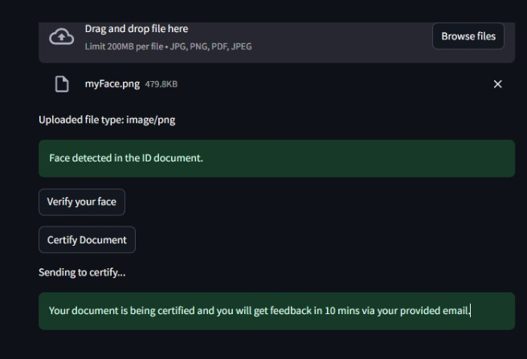
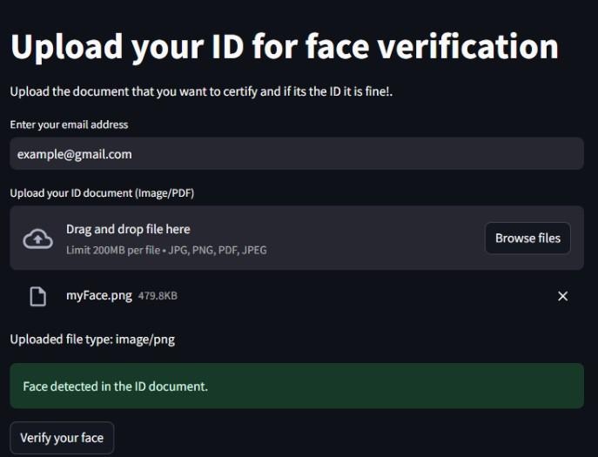
How the website works 1
Users will go to the website, make an account or login and upload the papers that need to be certified.
The website will also give information as to what type of document is acceptable, e.g pdf, docx, png, jpeg or jpg.
After uploading the document, it is reviewed by an approved certifier.
The user will also go through the facial recognition process to verify that they are the ones on their ID’s.

Slide 8
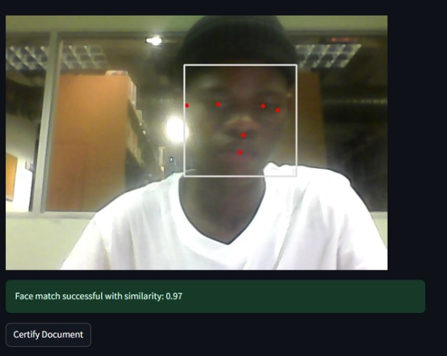
How the website works 2
After being verified and approved, the certifier will certify the document with a legal and secure digital stamp and a signature.
The user will then be notified that the process was successful and have the certified documents sent to them via e-mail.
The user will then be able to download and print out the document for their own use or upload it where they would need it to
This goes to show how efficient and easy Robotic Certifier has made things for users.

Slide 9

Legal and Compliance
Robotic Certifier follows the laws and is a legal website.
It follows data protection laws like GDPR and CCPA and digital signature rules, including proper methods for creating and storing digital signatures in order to be accepted by the government and private agencies and organizations.
Online certification should be legally recognized just like physical certification and meet national and international standards.

Slide 10
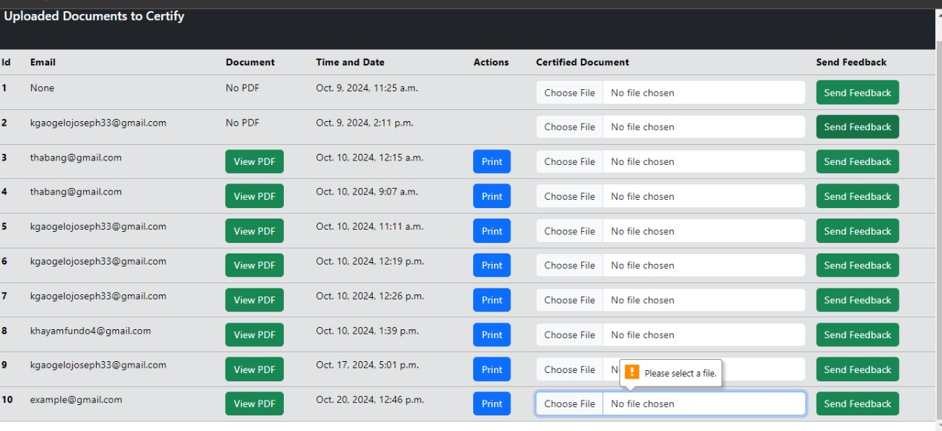
What makes the website unique
This website is unique because it is one of the first of its kind and it is rare to find a website that does what Robotic Certifier can do.
The platform is very user-friendly and allows even individuals with less technical skills to utilize it easily.
The platform handles certification requests automatically, and authorized people will finish the evaluation faster.
Also, it is very cost and time saving because you will not have to pay to go to town to certify and you can still be busy with your own work while waiting for the verification process to load.

Slide 11

Future expansion
Robotic Hub plans on expanding Robotic Certifier in the future with new services
These include online permits, license applications, notarization and as well as handling other legal documents.
These additional services would minimize the burden on government agencies while increasing the platform's utility.
We also aim to take Robotic Certifier International by collaborating with other international agencies or organizations to assist other individuals to be able to certify documents while in other foreign countries.

Slide 12

conclusion
To summarize, our online document certification platform intends to speed and simplify the certification process by allowing users to certify their documents without having to visit police stations or post offices.
By offering this handy service, we help to decrease long lines at these locations, allowing law enforcement to focus on community safety and crime prevention.
Our mission is to provide a quick, efficient, and secure means to certify papers, thereby making citizens' lives easier and contributing to a safer environment by keeping more police officers on the streets where they are most needed.
Robotic Certifier to the world, Thank You.

